Slide 1
Jessie Younghusband School
Reception Class Parents’ Evening
2024 - 2025
June 2024

Slide 2
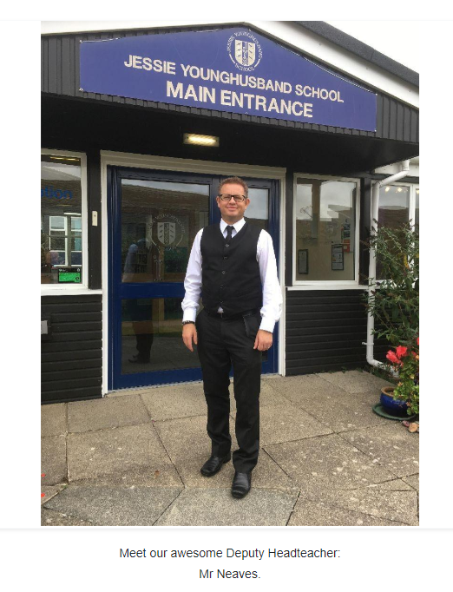
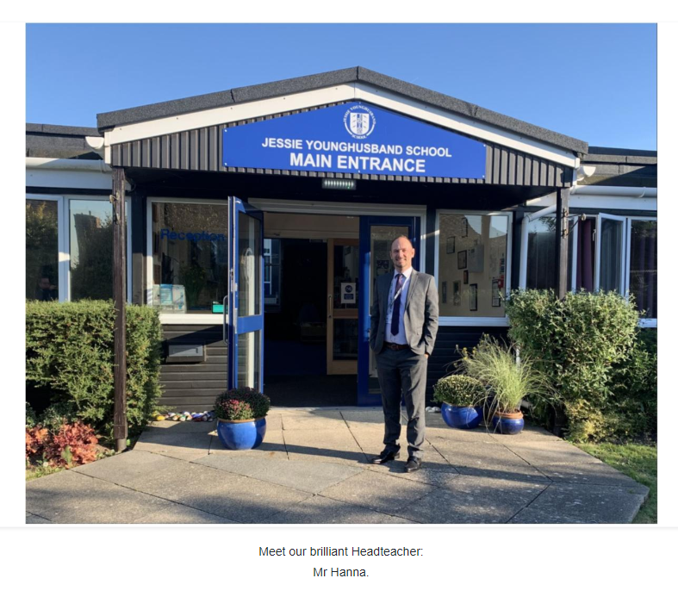
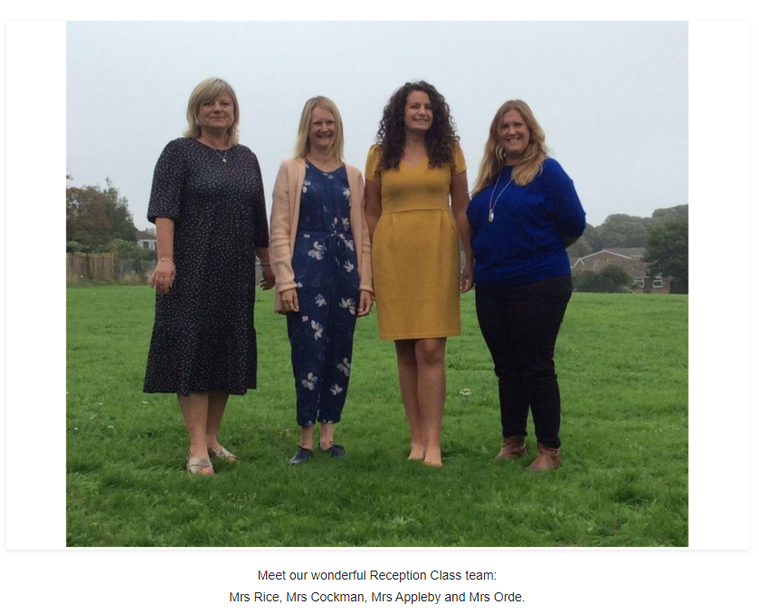
Introductions

Slide 3
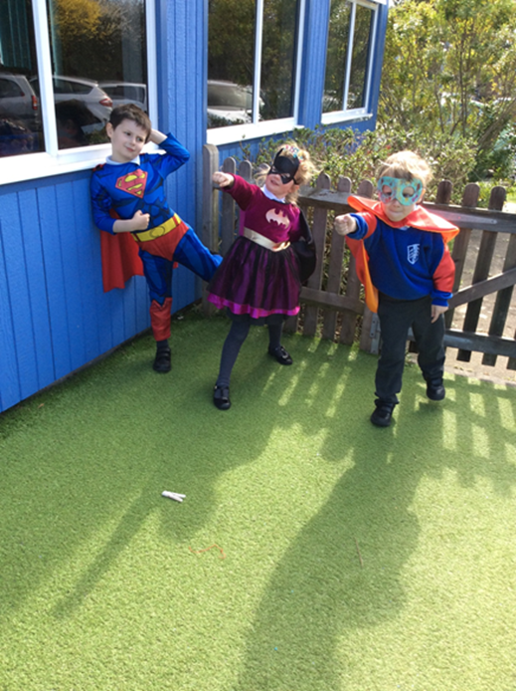
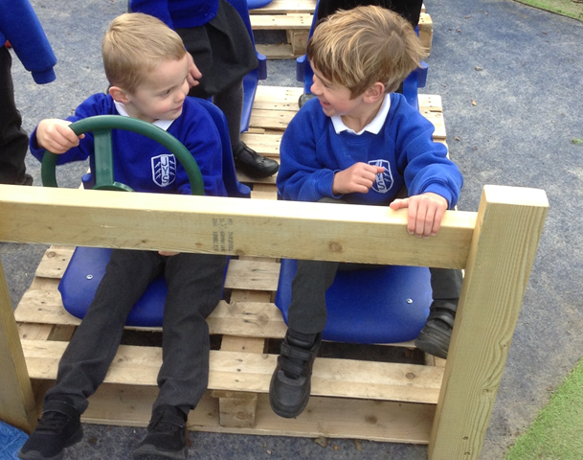
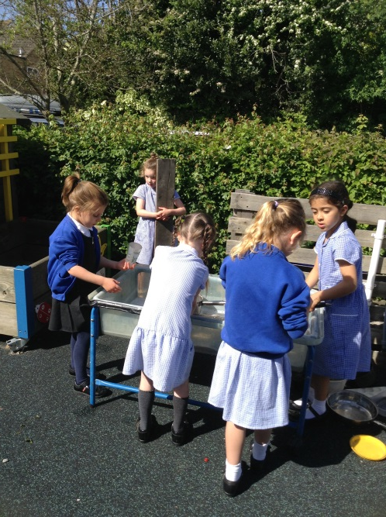
Reception Class
School Values
Aspire ~ Respect ~ Enjoy
School Aims
Provide a happy and safe environment where everyone is valued and respected.

Slide 4
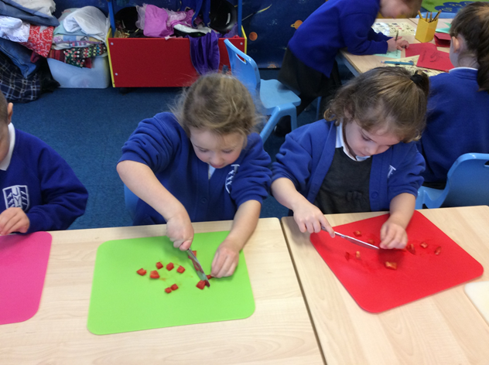
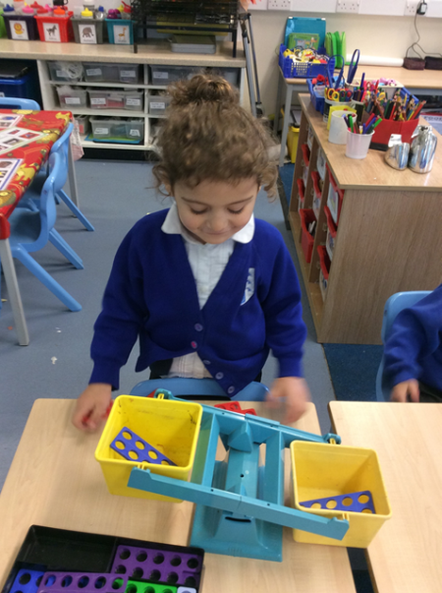
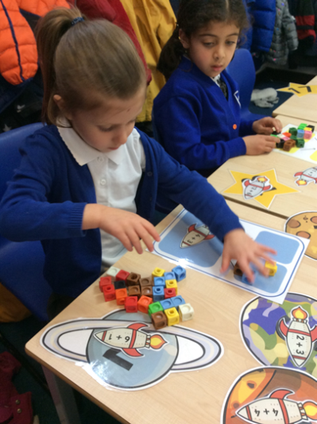
Aims for the Early Years Foundation Stage
Secure, safe and happy
Have fun!
High self esteem
Self discipline
Becoming independent
Communicating
First hand experiences
and learning through play
Moving into Key Stage 1

Slide 5
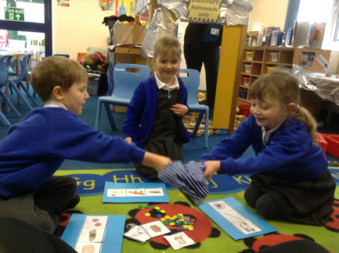
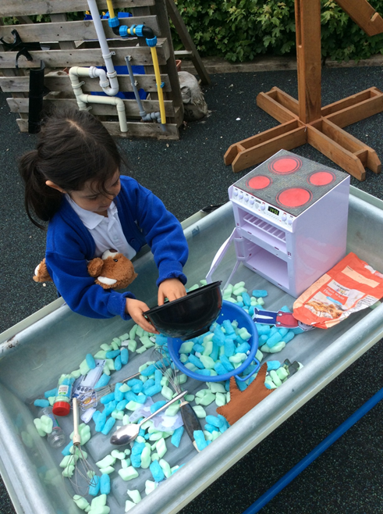
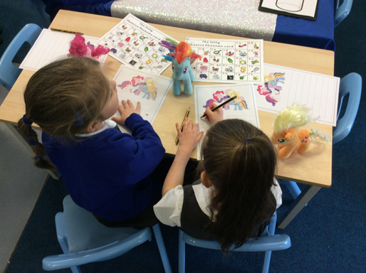
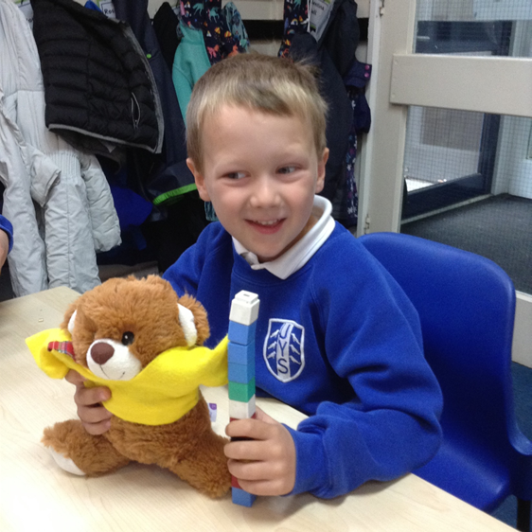
Areas of Learning
Prime Areas
- Personal, Social and Emotional
Development
- Communication and Language
- Physical Development
Specific Areas
- Literacy
- Mathematics
- Understanding of the World
- Expressive Arts and Design

Slide 6
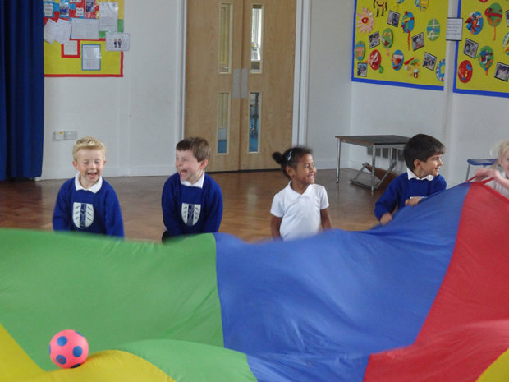
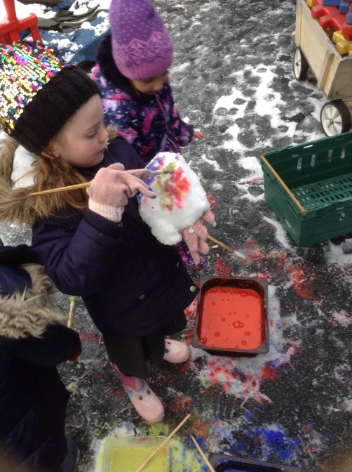
How do we ensure a smooth transition?
Transition event with all the nurseries to hand over key information in May.
Parents information evening held at school in June.
Visits to Nurseries/Early Years settings to meet your child (home visit if this is not possible)
Package from me at the visit including flat Mrs Appleby.
Meet on the field Stay and Play Wednesday 3rd July 10.45-11.45am (adult to stay).
All About Me sheet (handed out at play on the field) so we can get to know your child and your family better.
Website section under ‘Classes’ – ‘New Entrants in to our Reception Class’ stories and videos.
Taster session to the classroom in September (adult to stay)
Parents network/whatsapp group (not monitored/run by school). Summer park meet-ups have been successful in the past.
Staggered start (timetables in your pack)

Slide 7
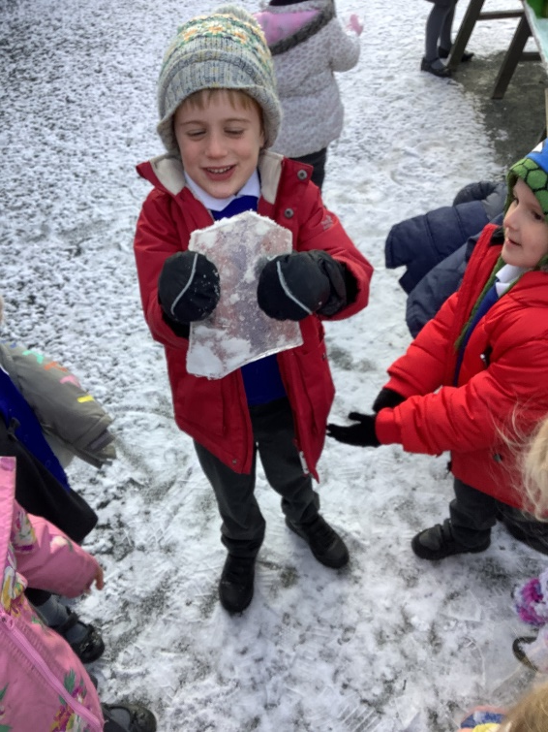
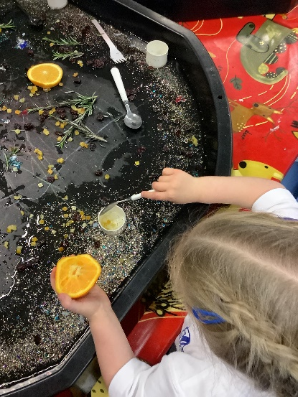
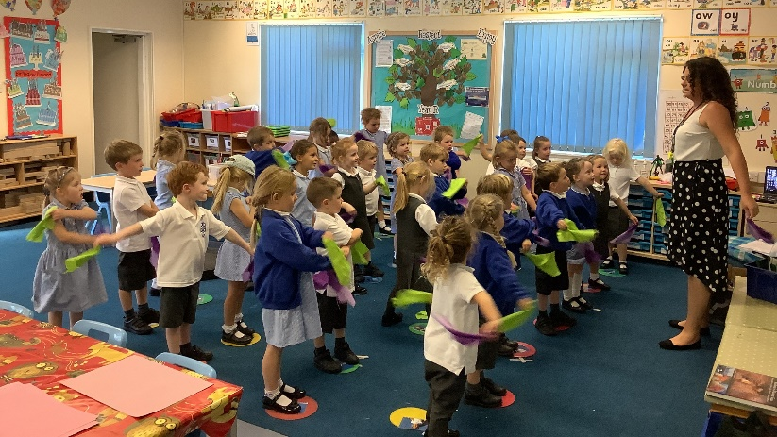
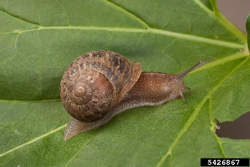
What does a typical day in Year R look like?
Our Reception class is the perfect mix of predictable and unpredictable!
Consistent routines and boundaries mean that the children feel settled and secure.
Awe, wonder and spontaneity is sprinkled throughout our day.

Slide 8
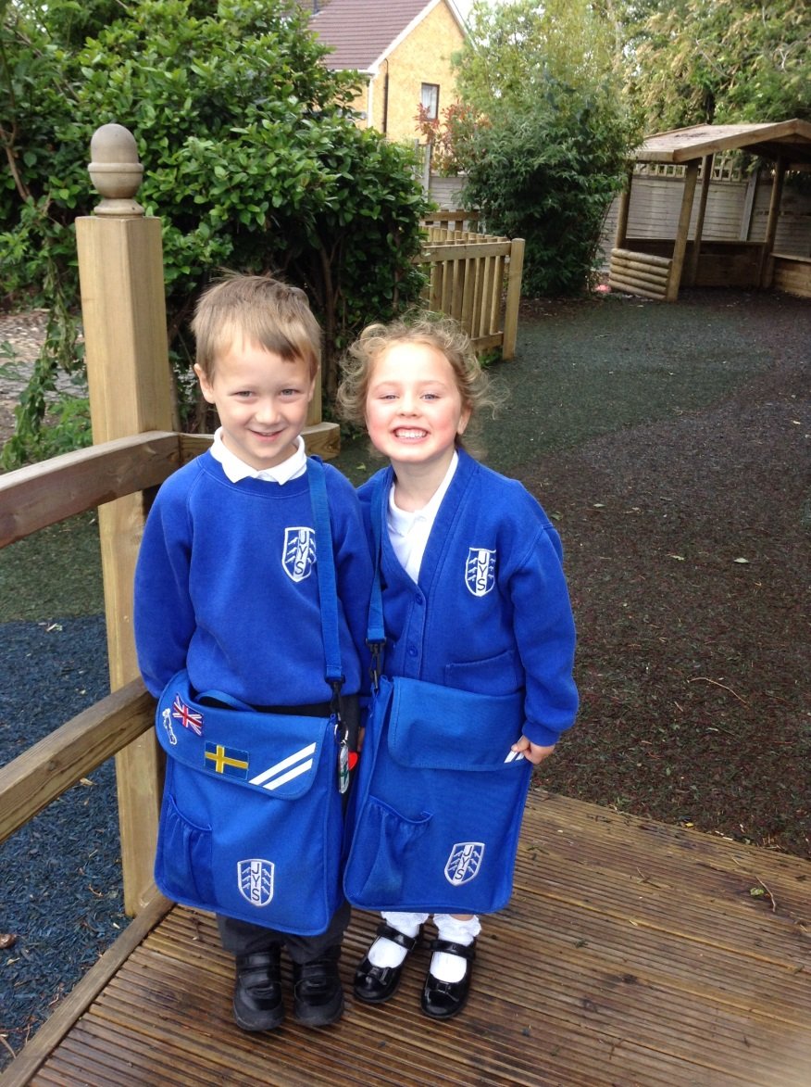
Your child needs to bring…
Clearly named book bag (no backpacks please) - Iron/sew on transfers that spell out your child’s name and favourite characters are really helpful. A keyring personal to your child is also great to help them to identify their bag quickly.
Water bottle - Filled with water each day (no squash please). Bottles that have a suck-release top are perfect as screw tops are difficult for the children to open independently and free-flow tops often get spilt. These can be of any decoration/design.
P.E Kit bag - no plimsoles are needed until the summer term - we will remind you then. White t-shirt (JYS branded or plain) and blue drawstring/sports style shorts.
Toy – We do not allow toys to come to school. They often get lost or broken and the children become upset; we have plenty in school!
Packed lunches - Every child in KS1 is entitled to a free hot dinner provided by Chartwells. If you choose to send them with a packed lunch instead, please note we are a healthy school (no sweets/chocolate/fizzy drinks) and nut aware (no nuts including peanut butter/hazelnut spread, nut based pesto sauce etc). You will also need to pack a separate drink for your child in their lunchbox.
Coat - Warm and waterproof for the colder months please and a light pac-a-mac style jacket for summer. A coat should be brought to school everyday regardless of the weather forecast. Please support your child to be able to zip their coat.
Sun hats - For when we are lucky enough to have warm weather. Please also apply suncream before they come into school in the morning and we will re-apply our school suncream before lunch.
Snacks- One piece of school fruit will be provided each day but we do not know what it is going to be. For example, some days we have tomatoes, other days we may have carrots. If your child will only eat certain fruits/veg you may consider sending your child in with a clearly labelled snack pot. Only fruit or vegetables please. Dried is also acceptable but these should be in their purest/rawest form e.g. raisins or dried apricots rather than packaged fruit bars/winders.
Wet weather wear- Please provide a pair of wellies and waterproof trousers that can be kept at school at all times.
Please name everything

Slide 9
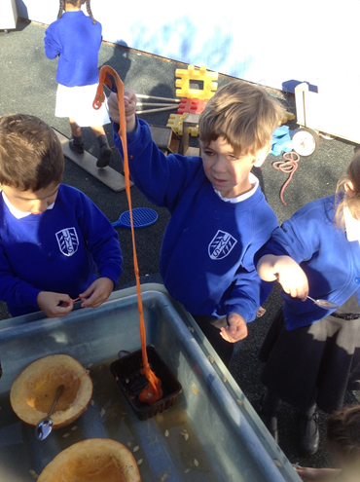
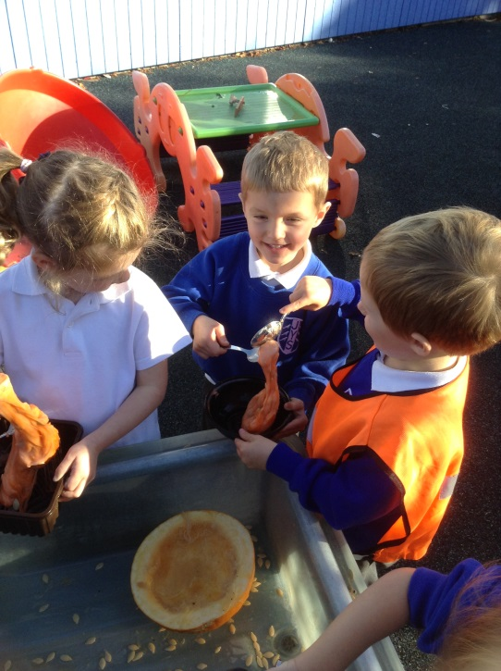
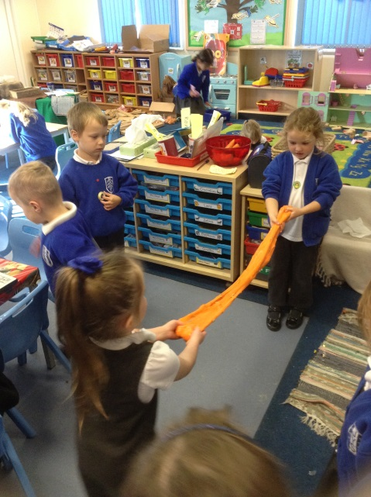
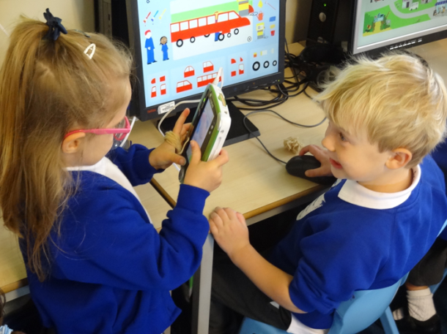
Start and end of the day…
Please take note of the parking plan (available on the website). The car park is for staff only please. Walking where possible is encouraged and a great time to chat with your child, notice the changes in nature and spot their friends along the way.
The playground is unsupervised at the beginning and end of the school day so please stay with your child until the Reception gate opens and you hand your child over to a member of staff.
After the transition period, your child should be dropped to school between 8.35-8.45am. After this time, your child be be marked as late and will need to enter school via the office. Reception class start to dismiss at 3.10pm in order to safely dismiss the younger children to their adults. Please be there in plenty of time and be patient with us as we learn your faces, grandparents and childminders…this can be in excess 100 adults for us to learn in the first couple of weeks.
Please make drop off swift during those first days. If you are confident and positive, your child will pick up on this and be more confident coming into school too. We are there to help. We will also keep you updated through Tapestry so you know they will be having a great time (please keep an eye in your e-mails for Tapestry sign up links.

Slide 10
Useful information…
PE lessons typically happen once a week but these can look different in EYFS. Sometimes this is a ‘traditional’ PE lesson such as dance of gymnastics and others it will be a gross motor session using the large bikes, trim trails and playground equipment.
Jewellery: only one simple stud in each ear is permitted but these do need to be taped for PE lessons. It is helpful if the children are not wearing them at all as we are physical a lot of the time in EYFS.
Please report absences on the day to the school office.
Free school meals (this is different to the hot dinner provided to all children in KS1). If you are a low income family you may be eligible to ‘free school meals’ which means not only will your child receive a free hot dinner beyond KS1 but other benefits too such as funded holiday club places and additional funding for the school. Please follow the link here to check your eligibility: https://www.westsussex.gov.uk/education-children-and-families/schools-and-colleges/free-school-meals/#how-to-apply

Slide 11
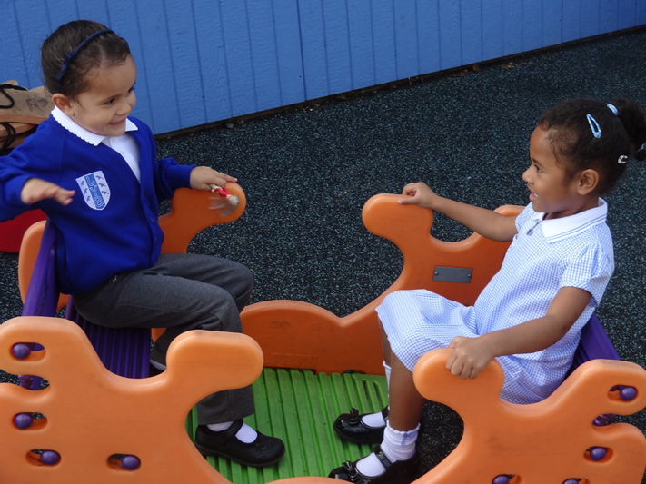
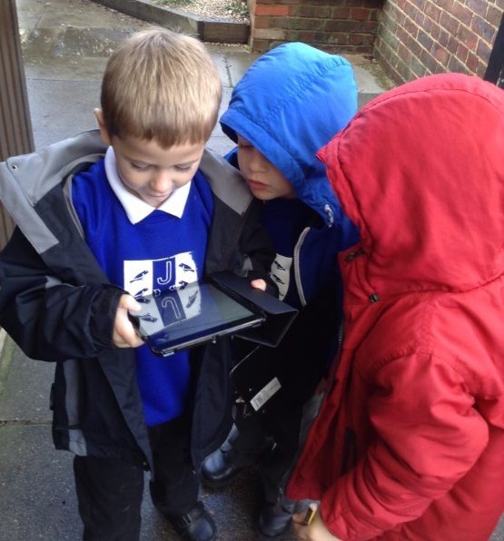
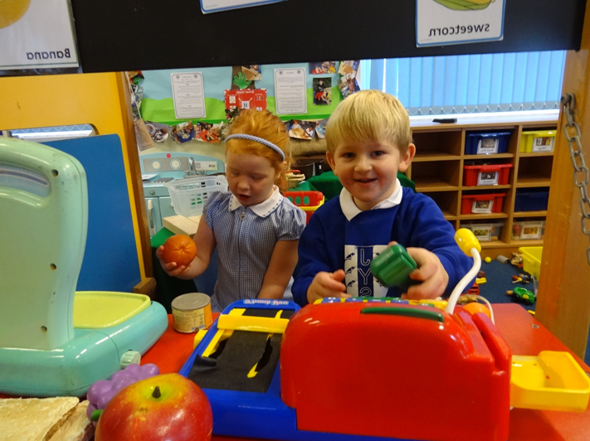
First days…
Monday 2nd September INSET day
Taster sessions on Tuesday 3rd and Wednesday 4th September.
Part-time timetable for the first week from Thursday 5th September (timetables are in your packs)
All children will be full time by Thursday 12th September.

Slide 12
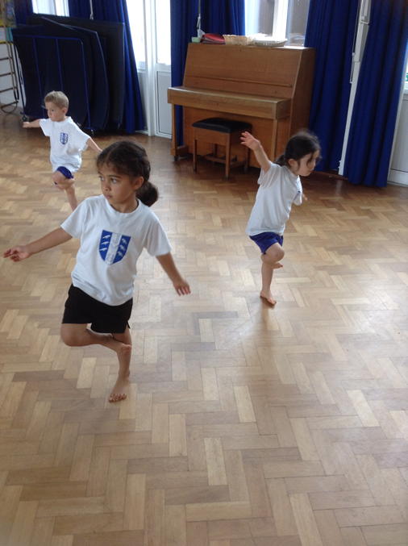
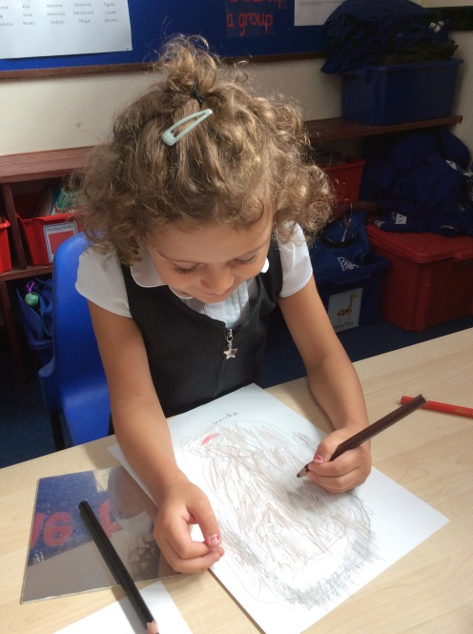
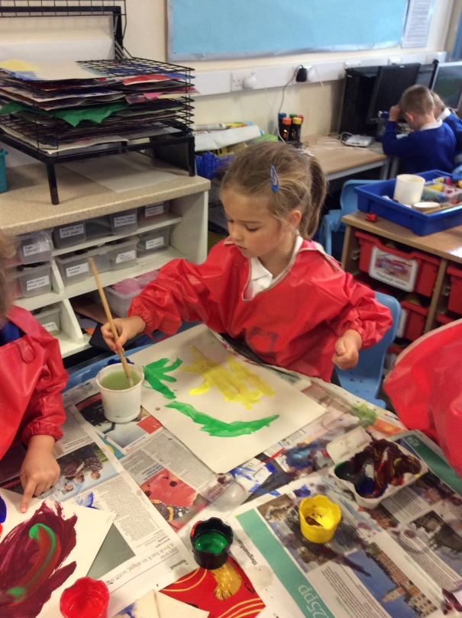
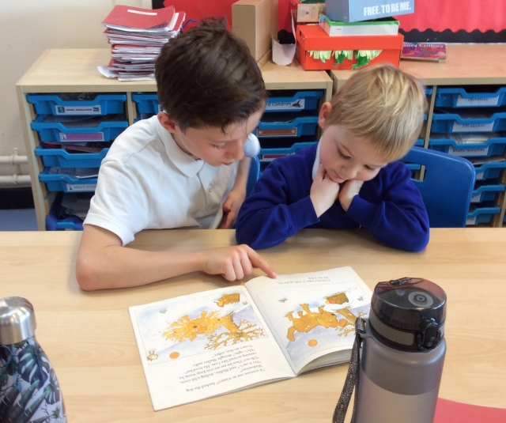
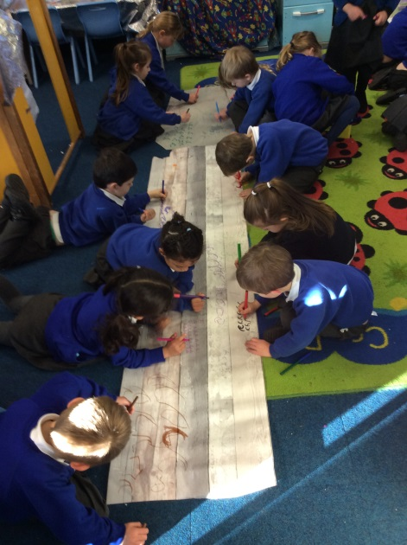
How you can help…
Sing with your child (nursery rhymes are a great place to start).
Read with them every day, encourage them to talk about the pictures in the book or to guess how they think the story is going to end, or ask them how they think the characters might be feeling- happy/ sad. Foster a love of reading early!
Help them to recognise their name (so they can identify their belongs and coat peg etc), even write their name if they are showing an interest in mark making/ writing, but there is absolutely no need to do this if your child does not seem interested as this will all be taught when they come to school. If you are teaching them to write their name, please only a capital letter at the beginning, not the whole name in capitals.
Encourage them to be as independent as possible - so help them to learn to put their shoes and coat on independently, to get undressed or dressed. This will really help them when they start to change for P.E and when changing into wet weather gear. Play musical get changed as a family! Encourage your child to be able to verbalise their needs.

Slide 13
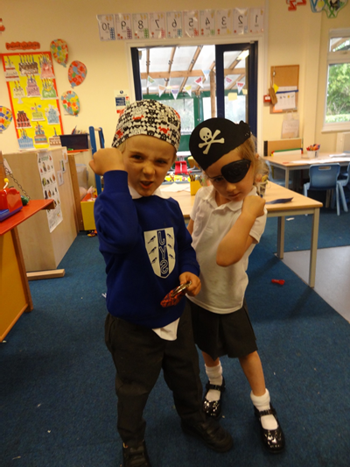
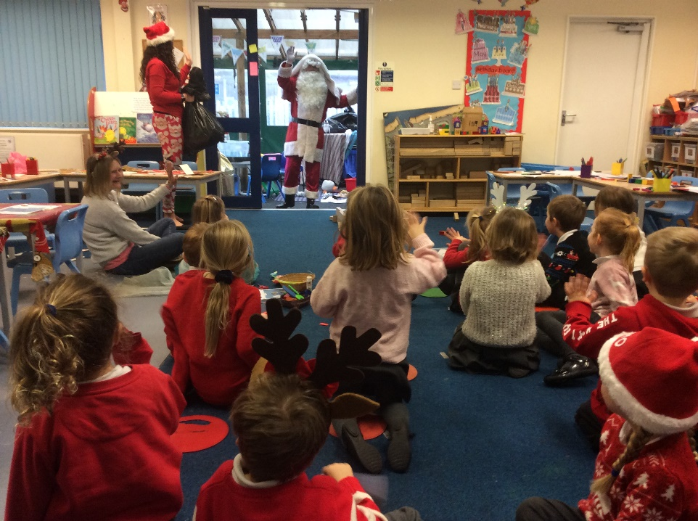
Become part of the community
Friends of JYS (PTA) organise lots of fantastic events over the year to raise money to directly benefit our children. They are always keen for more helpers!

Slide 14
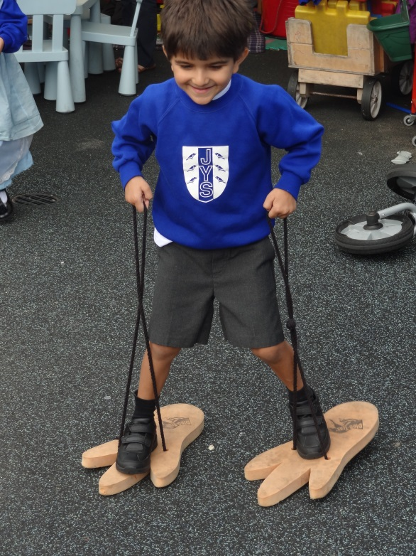
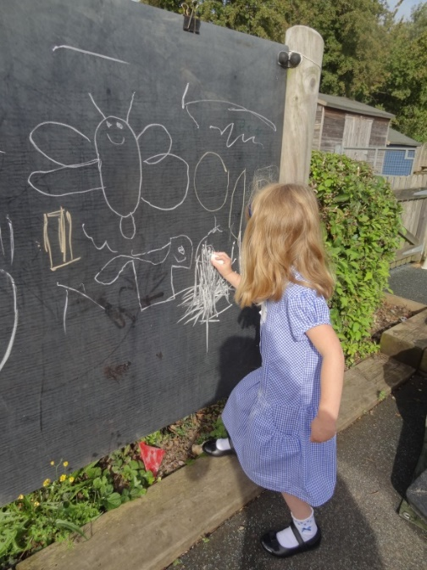
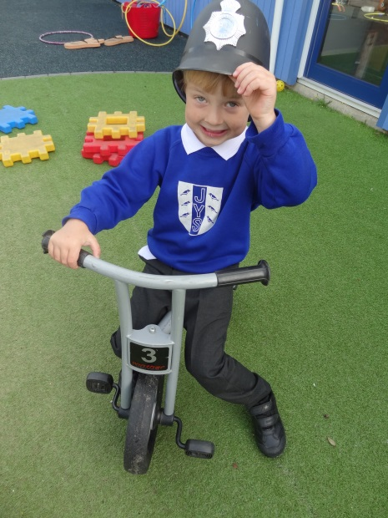
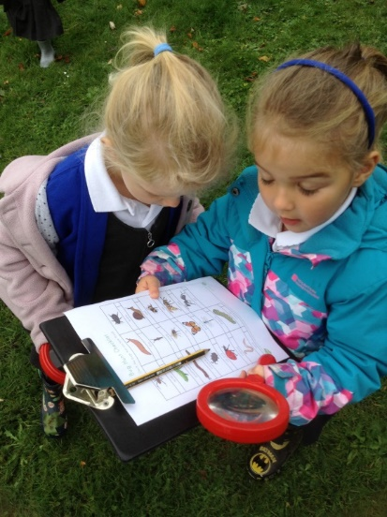
Final notes
Please return booklets/forms by Wednesday 3rd July.
Any questions? Please email to office@jys.org.uk
Welcome to our school community!

