Slide 1
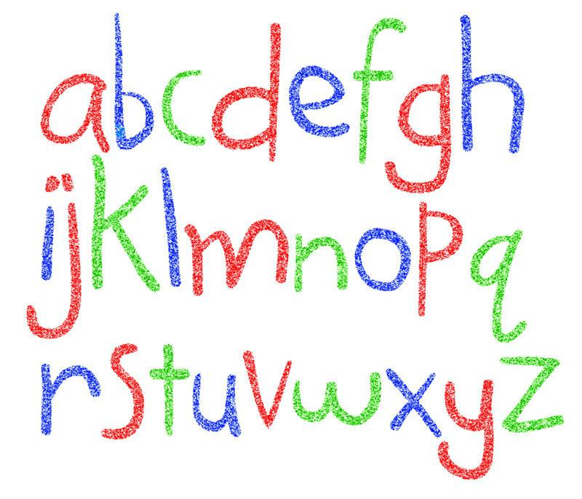
Phonics Workshop

Slide 2
Twinkl Phonics
Across the school, we use the Twinkl Phonics scheme to teach each sound.
There is a sound (known as a phoneme) e.g. “ah” to accompany each written letter (known as a grapheme) a, said “ay” with a catchy song and action.

Slide 3
Twinkl Phonics
There is also a handy letter formation rhyme

Slide 4
What does a lesson look like?
Each lesson starts with a ‘revisit and review’ session. This is a time to go over sounds learnt in previous lessons.
This is followed by the introduction of a new sound. For younger children this is daily, for older children this may be weekly.
There is an opportunity to apply what has been taught through reading games and/or writing activities.
There are also follow-up game, activities at workbooks that may be used in your child’s class.

Slide 5
Pronunciation of sounds
We know that phonics has changed over the recent years, as has the pronunciation of sounds. Sounds are said in a very ‘short’ way e.g F is ‘ff’ not ‘fer’ and L is ‘ul’ not ‘ler’ amongst others.

Slide 6
Early reading strategies
Each child develops and progresses at their own speed.
A love of reading, and being read to is so important. A bedtime story routine perhaps?
Shared/Paired reading: ‘I’ll read this page, you read the next’, or ‘can you read this word in my book?’
Spotting and reading road signs/shop names whilst out and about.

Slide 7
What is early reading?
Putting sounds together is called blending. Say the sounds faster and faster until they blend to make the word:
c---a---t c--a--t c-a-t cat
We call this ‘robot talking’.
You can play this as a game:
Can you tap your ‘h-ea-d’
Can you wiggle your ‘n-o-se’

Slide 8
I can’t read!
With only a few sounds learnt, your child can begin to read.
Set 1- s a t p i n
Can make:
at, as, in, it, tip, pin, sat, nip, pit, sip, tap, sit…

Slide 9
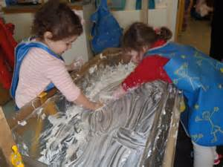
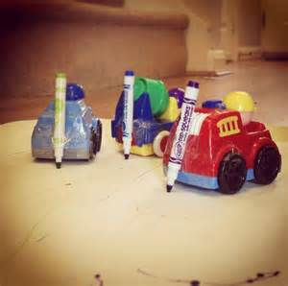
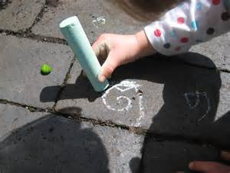
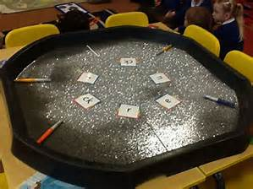
Mark making
Mark making is children’s first attempts at early writing. This presents itself as squiggles and wiggles initially and can be done in many forms.

Slide 10
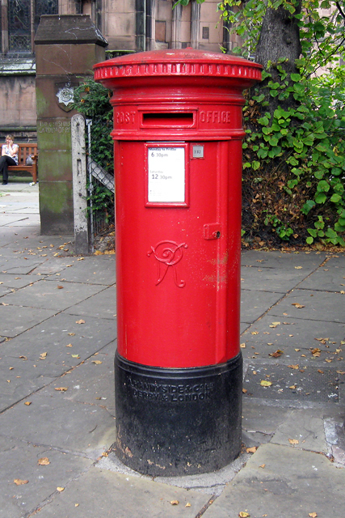
Encouraging writing at home
Shopping lists;
Celebration cards;
Post cards;
Letters to fairies;
‘Family’ post box;
Christmas lists;
Leaving notes.
Where to start?
Pencil grip and name writing
Sam

Slide 11
Letter formation
Letter formation will also be in phonics folder, please take the time to practice these.
Rainbow writing or practical activities.
Encourage the correct letter formation rather than enforcing ‘bad habits.’
No capitals.

Slide 12
Thank you for coming!
Any questions?
At the end of this week your child will bring home a phonics folder.

